Slide 1
Secure data hiding in image using steganography
CAPSTONE PROJECT
Presented By: Swapnil Garg
Student Name : Swapnil Garg
College Name : S. S. Jain Subodh PG (Autonomous) College
Department : Computer Science

Slide 2
OUTLINE
Problem Statement
Technology used
Wow factor
End users
Result
Conclusion
Git-hub Link
Future scope

Slide 3
Problem Statement
Detection tools, like steganalysis, can identify hidden data, compromising its effectiveness.
Hidden messages may get corrupted or lost during file transmission or conversion.
Cybercriminals often exploit steganography to hide malware or communicate covertly.
As its use can violate privacy regulations or encryption laws.
Steganography can increase system complexity and resource consumption, impacting overall performance.

Slide 4
Technology used
Programming Language : Python version-3.13 (IDLE)
Image Processing Library : openCV2 version-4.11.086
File Handling & Security : Basic encryption logic for password protection
Platform : Windows 10
Office Automation Tool : Microsoft Power point
Other Specification : Hard Drive for Storage, RAM Storage, Snipping Tool for take screen shot of a result, GitHub for sharing project, Internet and Command Prompt.

Slide 5
Wow factors
Works on any standard image file format like JPEG, JPG, BMP and PNG. (PNG recommended for best results)
Project could allow for secure file sharing where the data is encrypted, embedded, and sent through cloud storage or cloud-based communication channels.
Project might include mechanisms to actively prevent detection by commonly used steganalysis tools.
User-friendly GUI for easy encryption and decryption. Project have a simplified, intuitive interface that makes it accessible for non-technical users.
Project might allow for cross-platform or cross-medium embedding (e.g., hiding data in images, videos, audio, and text) with the same or similar level of effectiveness.

Slide 6
End users
Government and Intelligence Agencies : Steganography can help in hiding information in plain sight, ensuring it is not easily detectable by adversaries.
Journalists and Whistle Blowers : To protect their identity and keep their sources anonymous when sharing classified or confidential information.
Military and Defense : It can be applied to hide instructions or covert operations within seemingly harmless files or media.
E-commerce Platforms : To protect customer data, such as payment details or personal information, ensuring that even if data is intercepted, it cannot be easily extracted or misused.
Telecommunication Companies : To provide secure communication channels over their networks, ensuring that sensitive business communication or government correspondence remains private even in the event of network breaches.

Slide 7


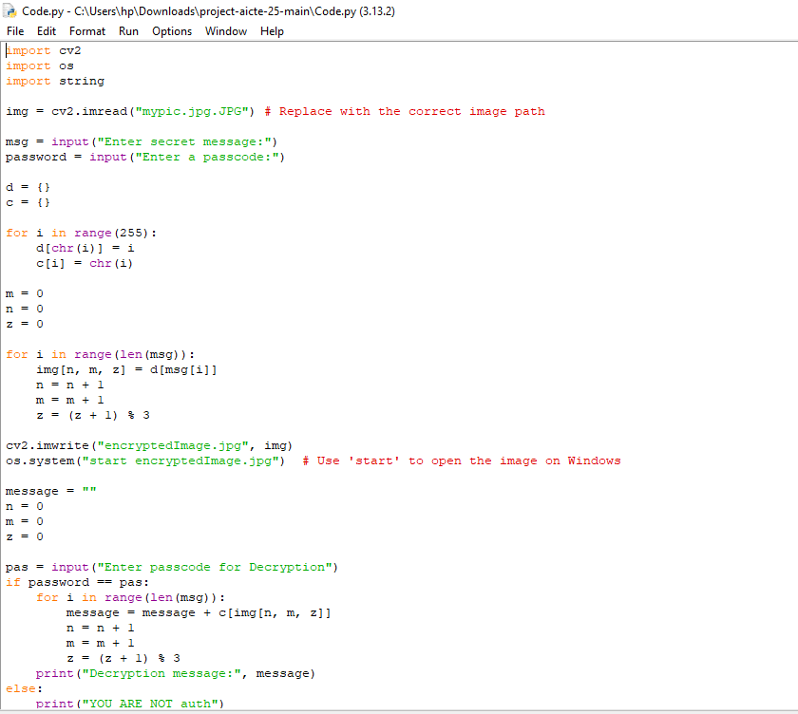
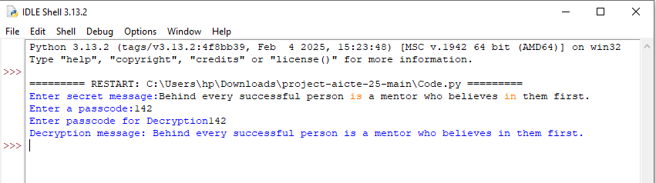
Results
Input Image File :
Output Image File :
Code of Data Hiding:
Encryption and Decryption Output :

Slide 8
Conclusion
By hiding data within seemingly innocuous files, whether images, audio, video, or text, steganography offers a unique layer of protection beyond traditional encryption techniques.
This covert method allows for the secure transmission of sensitive information, making it invaluable for government agencies, cyber security professionals, journalists, privacy advocates, and even everyday users who wish to protect their data from prying eyes.
This project showcases a simple yet effective implementation of message hiding in images.
Cybercriminals may exploit these methods for malicious purposes, such as hiding malware or exfiltration sensitive data undetected.
Future improvements can make it more robust, secure and scalable.

Slide 9
GitHub Link
https://github.com/Swapnil-Garg/Cyber-Security-AICTE--Project-on-Hiding-Data-Using-Steganography--.git

Slide 10
Future scope(optional)
Forensic Applications: Tools to detect hidden data in seemingly innocent files or media will continue to evolve.
Digital Media and Social Networks : As social media continues to grow, steganography could offer a means of covert communication. There is an opportunity to use steganography for embedding secret messages in videos, photos, and even GIFs or memes.
Enhanced Security and Privacy : Combining steganography with other techniques, such as encryption, would offer a more robust approach to security.
Cloud Computing and IoT : With the explosion of cloud computing, steganography may find use in securing cloud data. As the Internet of Things (IoT) continues to expand, the need for secure communication among devices grows.

Slide 11
THANK YOU

